Slide 1
Budget Sustainability and Fiscal Implications for the City
City Council Presentation
April 13, 2026

Slide 2
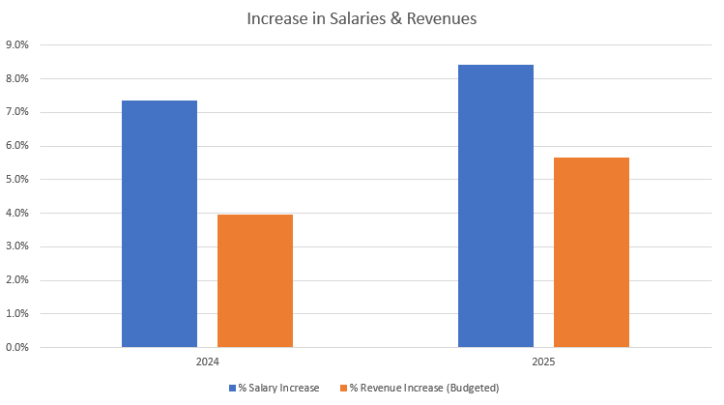
Background and Context
Surplus
  $9.7 million in 2020
  Increased to $20.1 million by 2025
    One-time revenues (Covid Relief, Fire Service Catchups, Interest Income, etc.) totaled $11.3 million from 2020 - 2025
Salary & Benefits
  Not including increases in overtime, salaries and benefits increased between $4.5 - $5 million (6% increase in wages each year)

Slide 3
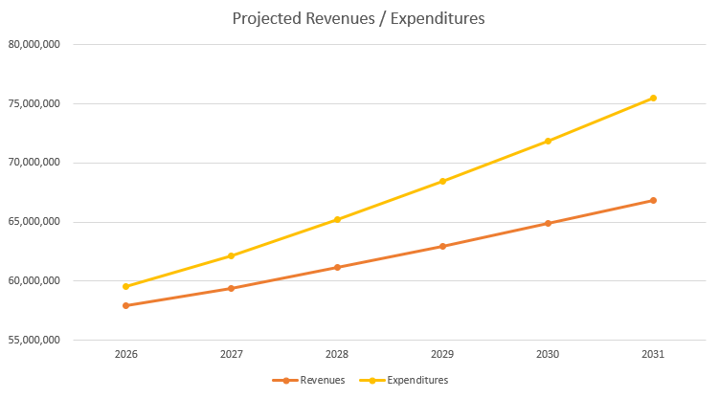
Long-Term Sustainability Considerations
Year over year revenue projections, based on historical trends, equal an average increase of 3%
The City’s expenditures have increased on average 6.75% over the last three fiscal years
FY27 increase in employee Health Insurance, Liability and Property Insurance, Utilities, etc.
Borrowing concerns from MDE, Credit Rating
OPEB (Other Post Employment Benefits)
Current projections show no surplus left as soon as FY30

